Slide 1
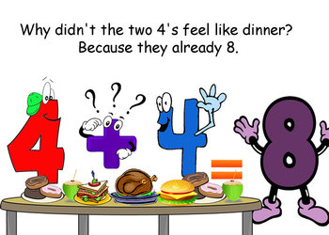
Number
Term 1
Semester 1
Teacher:
Class:

Slide 2
Contents
Glossary or Formula Page
Page
Date
Description
2
3

Slide 3
Tasks
24
7
30
Essential Question
Questions
Notes
Summary
4
5

Slide 4
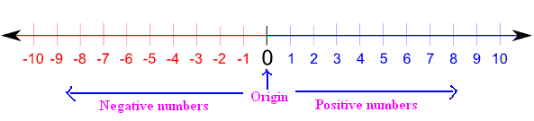
24
7
30
Topic: INTEGERS
Date
Essential Question:
What are integers and how do they relate to math?
Questions
Notes:
Any positive or negative whole numbers or zero
What is an integer?
Which number is
-4 1
-1 8
3 -10
5

Slide 5
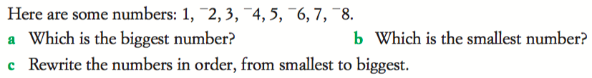
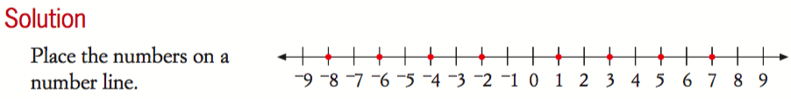
LEFT HAND SIDE

Slide 6
Quiz time – 7 questions

Slide 7
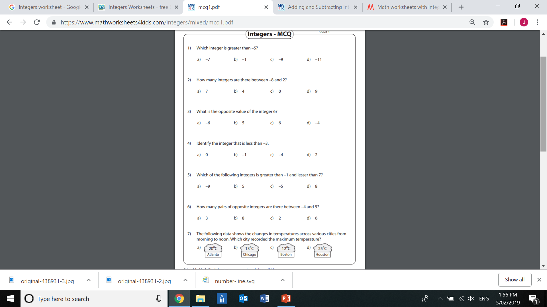

Slide 14

LEFT HAND SIDE

Slide 15
GAME TIME
Complete the table using numbers between 2 – 12
You can repeat numbers as many times as you like!
Rules:
Roll 2x 6-sided dice
Add the numbers
Cross off on your board

